Slide 1
Thinking about message
Describing a new model (fast, ML-enabled)
Compare/contrast to existing methods
Solution: combo of methods
New method – easy, but limited to sizes > pixel (higher MP = smaller particles resolved)

Slide 2
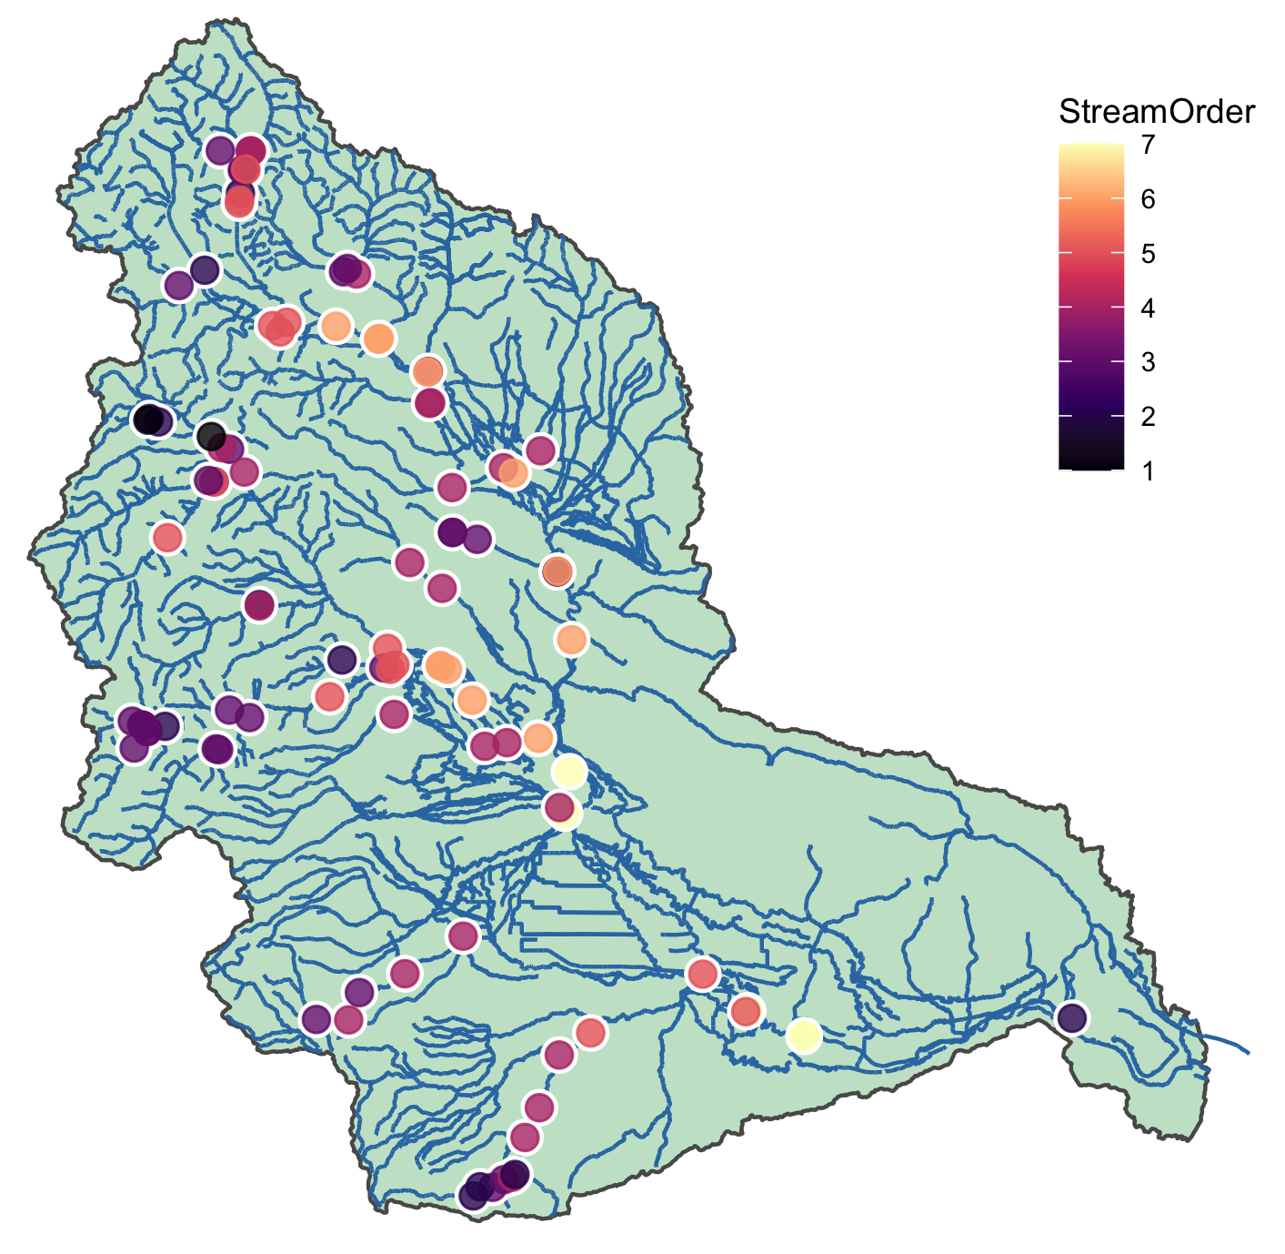
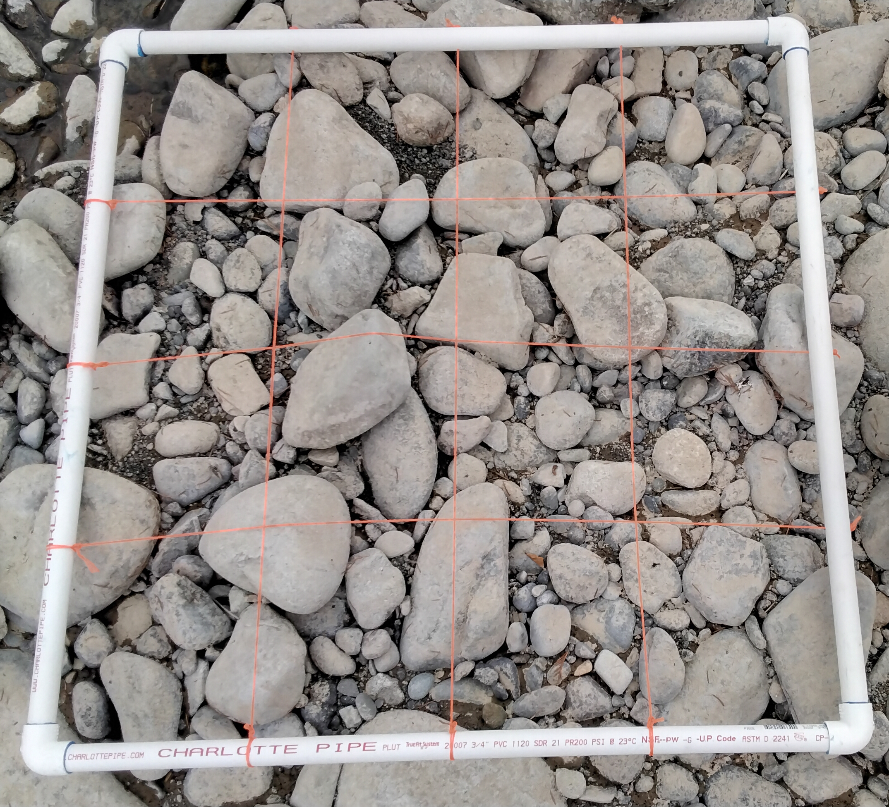
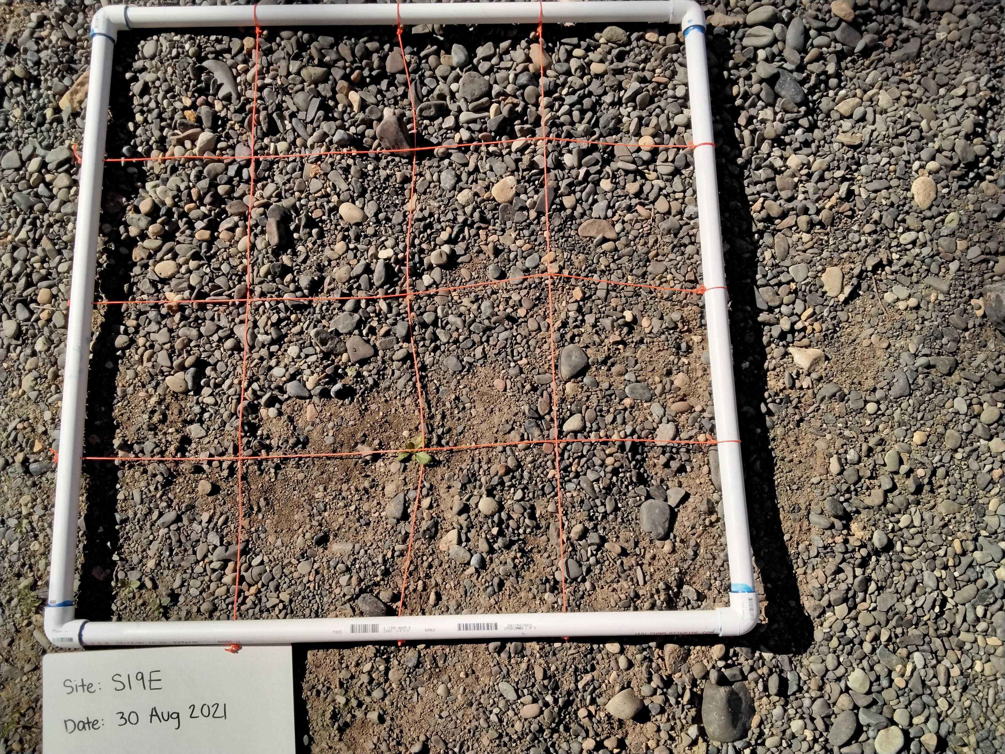
Figure 1 presents a map showing the characteristics of our samples, and two examples of pictures used to
Estimate d50
A
B
Take-homes:
Our study sites cover a large, heterogenous watershed and represent headwaters to main stem sites
Stream beds vary dramatically in particle size distributions across sites, as evidenced by the two images
C
https://www.flickr.com/photos/ecologywa/34053439771 for map color inspiration

Slide 3
Table 1: comparison of d50 estimation methods
Method | Procedure | Range (mm) | Limitations
USGS | Manual sieving | < 2 mm | Misses large fraction
NEXSS | Model |  | Sig. generalizations
Abeyshu et al. 2022 | Model |  | Sig. generalizations
YOLO (this study) | Computer vision | > 2 mm | Misses small fraction, misses buried particles

Slide 4
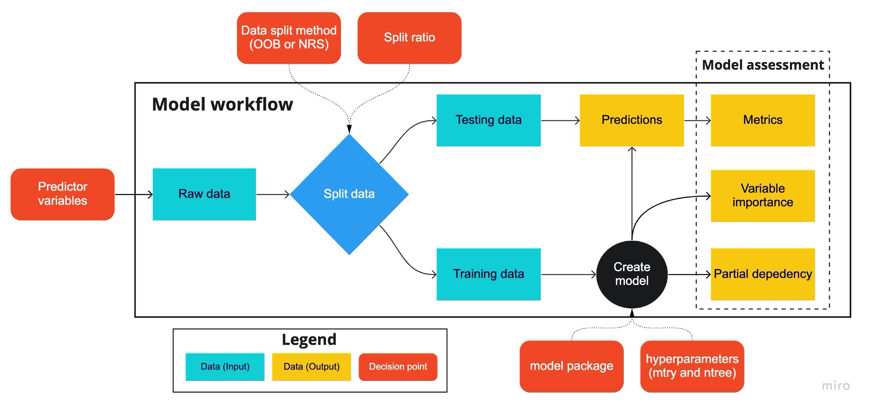
Figure 2 (or supplemental if less important): workflow and example of YOLO ID
Need to coordinate with YC on what needs to be in this / how to format (or borrow from his ppt?)
Can this figure also include an image showing particles identified?
Include pictures of how USGS/etc are calculating to show differences in methods
This should be a table: method, limitations, parameters, etc

Slide 5
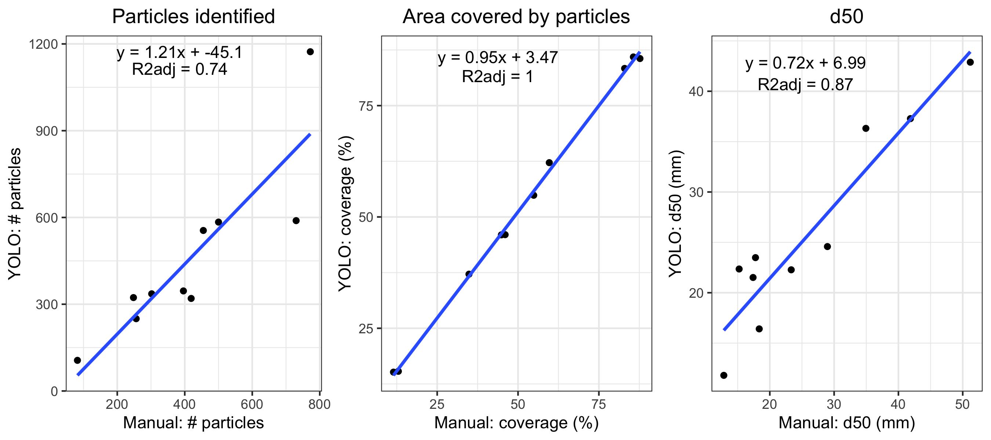
Figure 3: model strength and results
The model works well at predicting d50, and does a good job of representing the number of particles present and the area of the image covered by particles

Slide 6
Image LOD
Remake then rewrite
Alternative to boxplots for comparing distributions
Resolution is 0.2-0.6 mm

Slide 7
Gupta
Do patterns make sense with what we know about
Watershed characteristics? How do differences in patterns here relate back to methodological differences, and what might that tell us about bias?
NEXSS
d50
YOLO
Stream Order

Slide 8
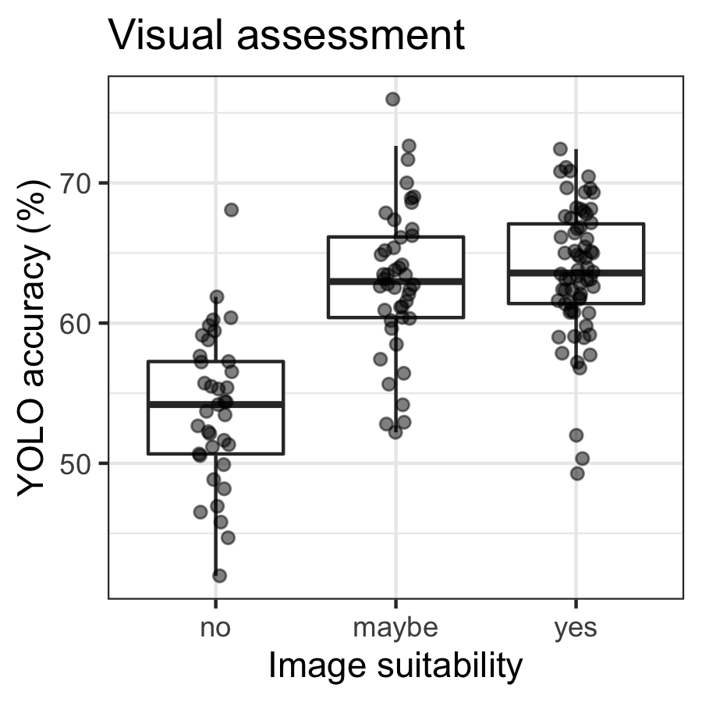
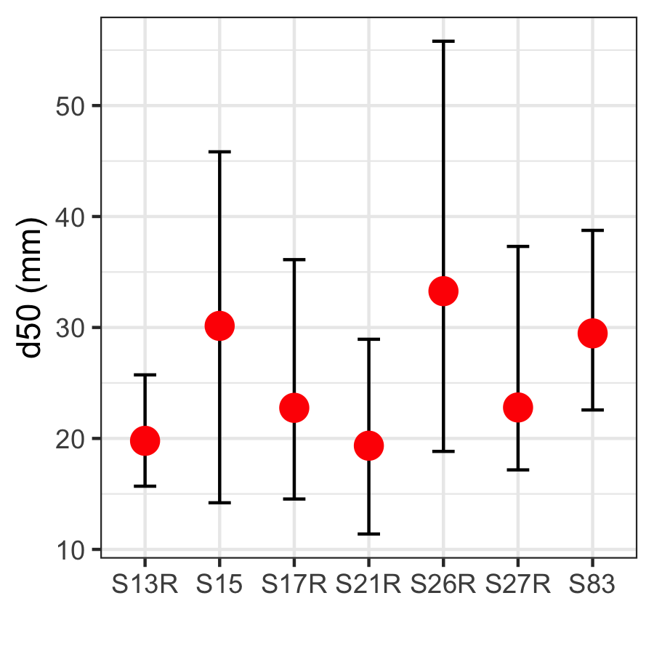
Compare how consistent YOLO estimates are for different pictures across the same site

Slide 9
Hypothesis-driven linkages between watershed characteristics Guta/NEXSS/d50
Which d50 estimate matches hypothetical relationships the best?
Different linear relationships OR lack of relationships
D50
Watershed characteristic that we expect to drive d50

Slide 10
Other images that may be useful
Maps of YRB for NEXSS, Guta, YOLO to compare spatial patterns
Comparison of sites with multiple images
Correlation between number of items and size (color by confidence)
Additional metrics (SF etc)
Boxplot: yes/no/maybe v confidence (human and computer vision match)

Slide 11
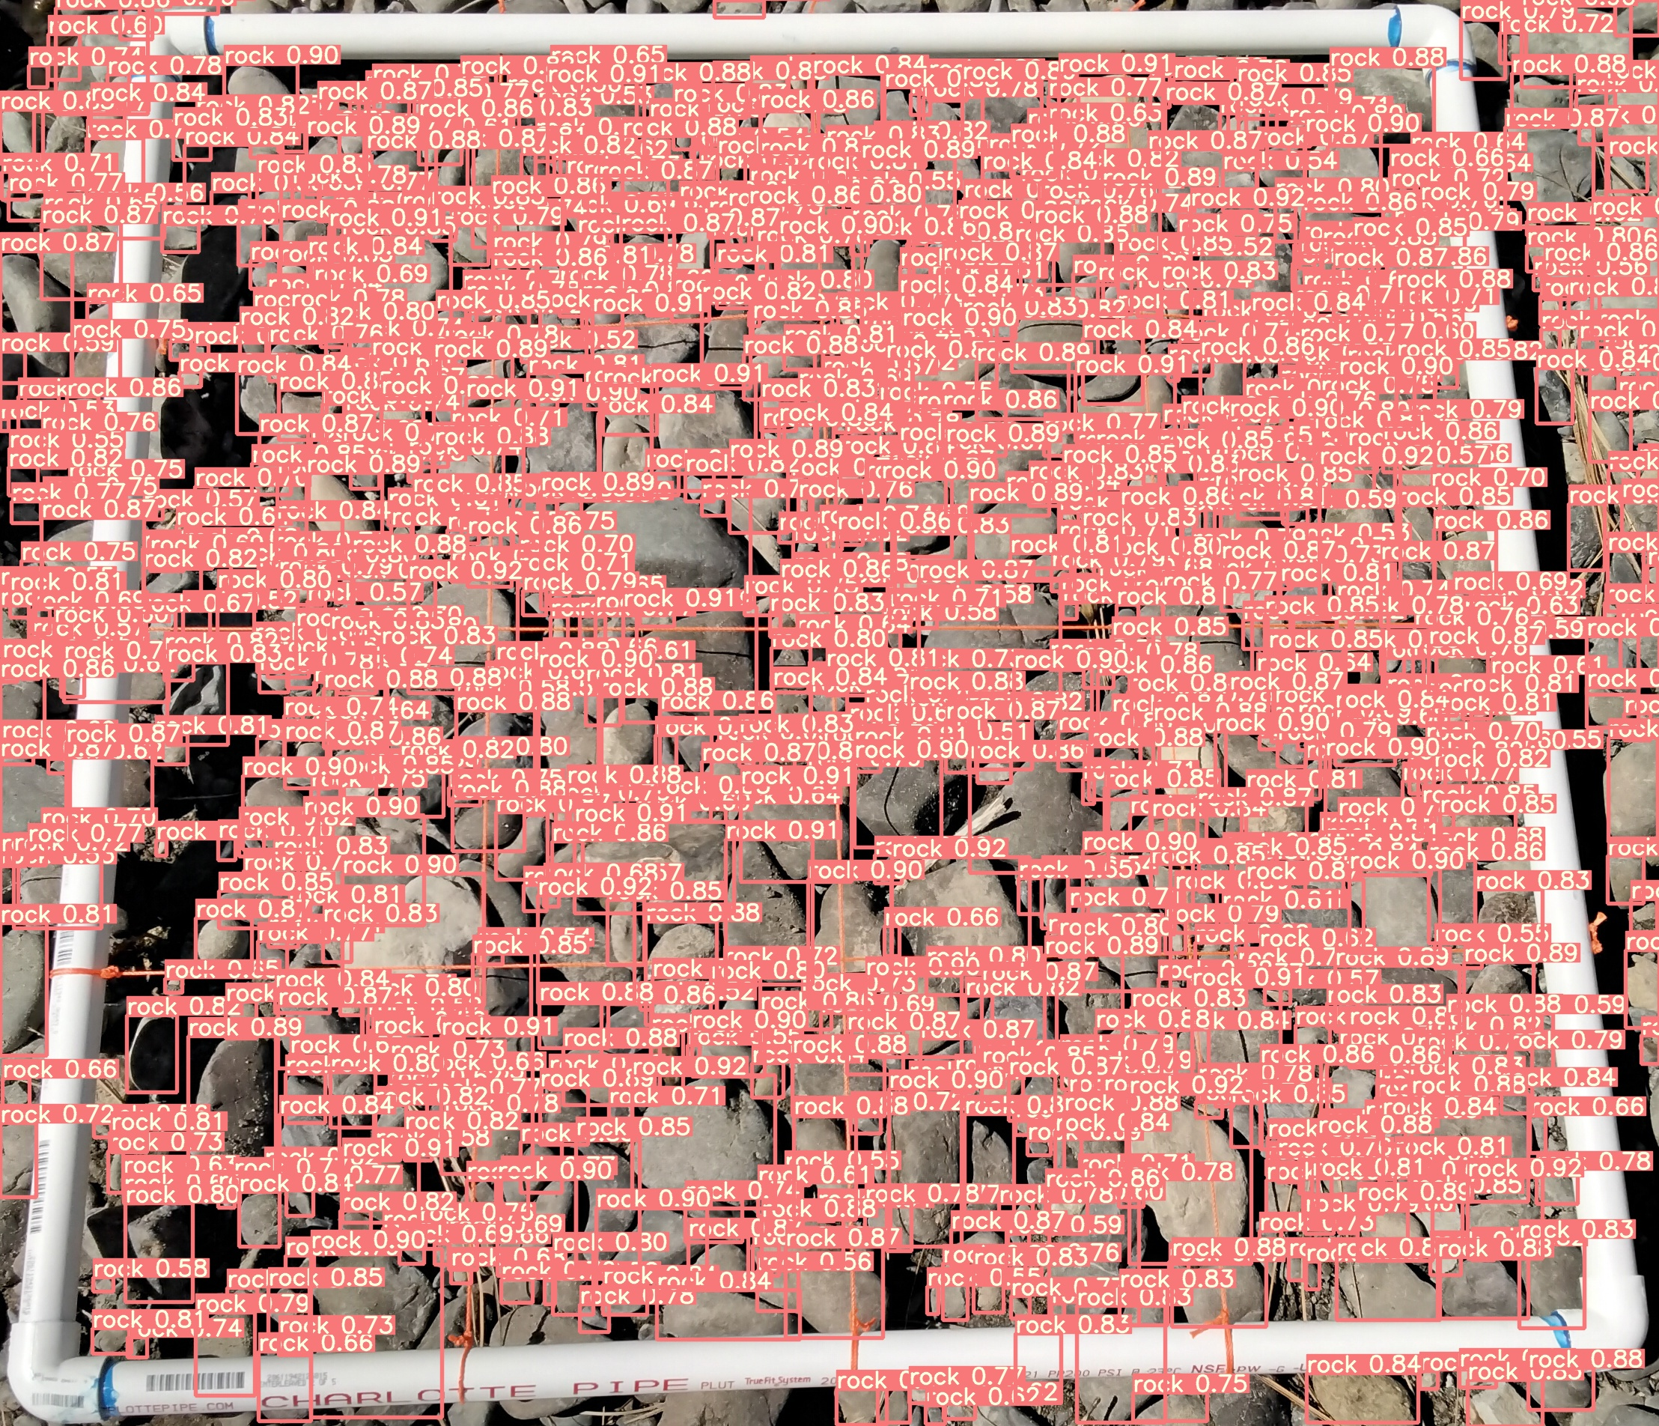
D50s for all YOLOs
Important to show the raw data (distributions) –
Figure out how to best show that

Slide 12
USGS
Will be YOLO
Add YOLO
Add YOLO
D50s for all YOLOs

Slide 13
Smallest particle resolved
MP
Should be a completely straight line, but highlighting how a better camera will help resolve more sand particles

Slide 14
Next paper
Respiration rate boxplots by d50 input

